Slide 1
Operating Systems CS2006
Chapter: 4
CPU Scheduling-II

Slide 2
What’s in today’s lecture
Basic Concepts
Scheduling Criteria
Scheduling Algorithms

Slide 3
Scheduling Algorithms
First come, First serve (FCFS)
Shortest Job First (SJF)
Priority Scheduling
Round-Robin Scheduling
Multi-level Queue Scheduling
Multi-level Feed back queue Scheduling

Slide 4
2. Shortest-Job-First (SJF) Scheduling
Associate with each process the length of its next CPU burst. Use these lengths to schedule the process with the shortest time
Two schemes:
  Nonpreemptive – once CPU is given to the process it cannot be preempted until the process completes its CPU burst
  Preemptive – if a new process arrives with CPU burst length less than the remaining time of current executing process, preempt. This scheme is know as the Shortest-Remaining- Time-First (SRTF)
SJF is optimal – gives minimum average waiting time for a given set of processes

Slide 5
Example of Non-Preemptive SJF
Process Arrival Time | Burst Time
P₁ 0.0 | 7
P₂ 2.0 | 4
P₃ 4.0 | 1
P₄ 5.0 | 4
■ SJF (non-preemptive)
P₁ |  |  |  |  |  |  | P₃ | P₂ |  |  |  | P₄
0 3 7 8 12 16
■ Average waiting time = (0 + 6 + 3 + 7)/4 = 4

Slide 6
SRTF - Shortest Remaining Time First
Preemptive version of SJF
Ready queue ordered on length of time till completion (shortest first)
Arriving jobs inserted at proper position
Shortest job
  Runs to completion (i.e. CPU burst finishes) or
  Runs until a job with a shorter remaining time arrives (i.e. placed in the ready queue)

Slide 7
Example of Preemptive SJF (i.e., SRTF)
Process Arrival Time | Burst Time
P₁ 0.0 | 7
P₂ 2.0 | 4
P₃ 4.0 | 1
P₄ 5.0 | 4
■ Preemptive SJF (i.e., SRTF)
P₁ |  | P₂ |  | P₃ | P₂ |  | P₄ |  |  |  | P₁
0
2 4 5 7
11 16
■ Average waiting time = (9 + 1 + 0 +2)/4 = 3

Slide 8
Shortest-Job-First (SJF) Scheduling
Ready queue treated as a priority queue based on smallest CPU- time requirement
  Arriving jobs inserted at proper position in queue
  Shortest job (1st in queue) runs to completion
In general, SJF is often used in long-term scheduling
Advantages: provably optimal w.r.t. average waiting time
Disadvantages: Unimplementable at the level of short-term CPU scheduling.Also, starvation is possible!
Can do it approximately: use exponential averaging to predict length of next CPU burst
==> pick shortest predicted burst next!

Slide 9
Determining Length of Next CPU Burst
Can only estimate the length
Can be done by using the length of previous CPU bursts, using exponential averaging
th
  t_{n}  actual lenght of n CPU burst
  ⧫ _{n1}  predicted value for the next (i.e., n 1) CPU burst
th
  ⧫ _{n}  predicted value for the n CPU burst
th
4.  , 0    1
⧫ _{n1}   t_{n}  (1 ) _{n} .
5. Define :
= 0 implies making no use of recent history ( _{n+1}   _{n})
= 1 implies _{n+1} = t_{n} (past prediction not used)
= 1/2 implies weighted (older bursts get less and less weight)

Slide 10
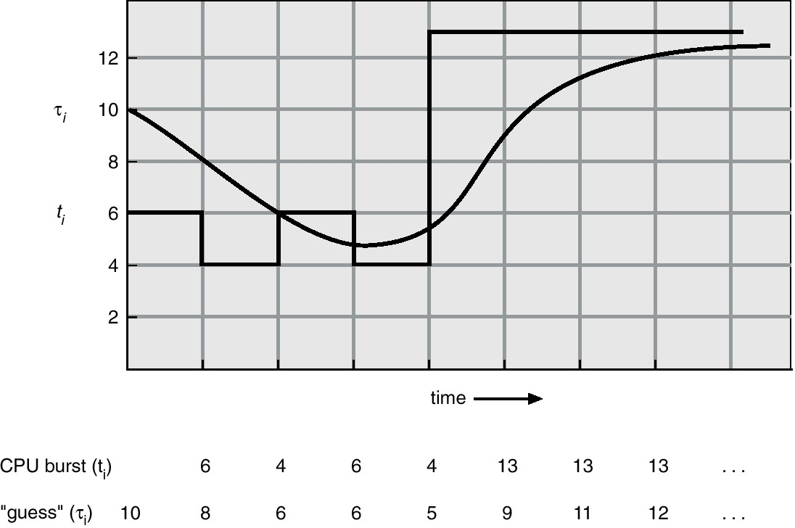
Prediction of the Length of the Next CPU Burst
This figure is for
  0.5 and  ₀  10

Slide 11
3. Priority Scheduling
A priority number (integer) is associated with each process
  Priority can be internally computed (e.g., may involve time limits, memory usage) or externally (e.g., user type, funds being paid)
  In SJF, priority is simply the predicted next CPU burst time
The CPU is allocated to the process with the highest priority (smallest integer might mean highest priority)
Starvation is a problem, where low priority processes may never
execute
Solution: as time progresses, the priority of the long waiting (starved) processes is increased.This is called aging

Slide 12
Priority scheduling
Priority scheduling can be Preemptive or Non- Preemptive
When a process arrives and enters the Ready Queue
Its priority is compared with the currently Running Process
If Higher
  Preemptive Scheduling
    Run the New process
  Non-Preemptive Scheduling
    Continue running the process

Slide 13
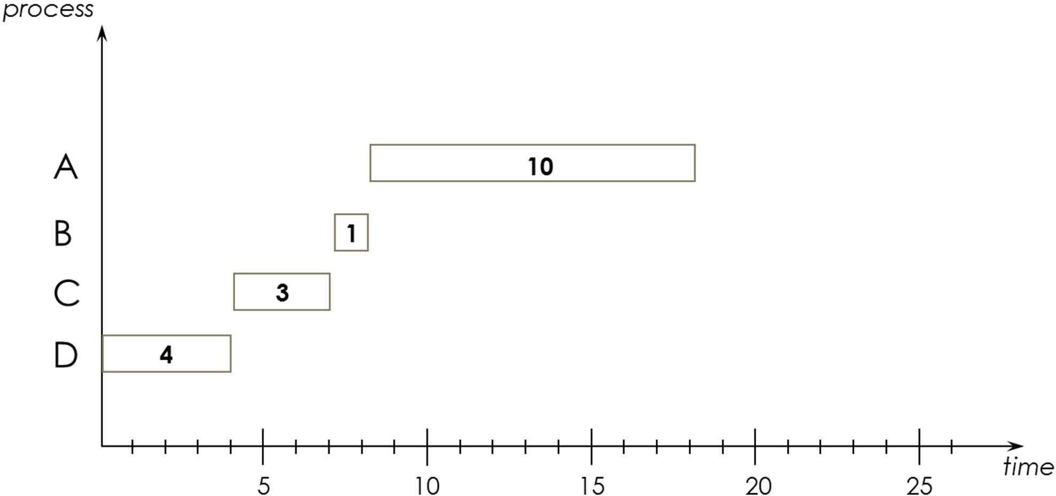
Priority Scheduling
process | priority | service time t_{s} | turnaround time t_{t} | waiting time t_{w}
A | 4 | 10 | 18 | 8
B | 3 | 1 | 8 | 7
C | 2 | 3 | 7 | 4
D | 1 | 4 | 4 | 0
AVERAGE 9.25 4.75

Slide 14
4. Round Robin (RR)
RR reduces the penalty that short jobs suffer with FCFS by preempting running jobs periodically
Each process gets a small unit of CPU time (time quantum), usually 10-100 milliseconds
The CPU blocks the current job when its reserved time quantum (time-slice) is exhausted
  The current job is then put at the end of the ready queue if it has not yet completed
  If the current job is completed, it will exit the system (terminate)

Slide 15
Round Robin (RR)
If there are n processes in the ready queue and the time quantum is q, then each process gets 1/n of the CPU time in chunks of at most q time units at once. No process waits more than (n -1)q time units
Performance: the critical issue with the RR policy is the length of the quantum q
  q is large: RR will behave like FIFO and hence interactive processes will suffer
  q is small: the CPU will be spending more time on context switching
 q must be large with respect to context switch, otherwise overhead is too high

Slide 16
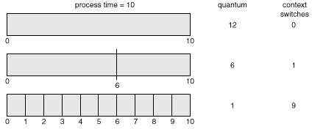
Time Quantum and Context Switch Time

Slide 17
Example of RR with Time Quantum = 20
Process
P₁ P₂ P₃ P₄
 The Gantt chart is:
Burst Time
53
17
68
24
P₁ | P₂ | P₃ | P₄ | P₁ | P₃ | P₄ | P₁ | P₃ | P₃
0 20 37 57 77 97 117 121 134 154 162
 Typically, higher average turnaround than SJF but better
response

Slide 18
Round Robin’s Disadvantage
Good for Varying sized jobs
But what about same-sized jobs?
Assume 2 jobs of time =100 each:
1 2 3 4 5
199 200
CPU
A | B | A | B | A
A | B | A | B
time
Avg completion time?
(200 + 200) / 2 = 200
How does this compare with FCFS for same two jobs?
(100 + 200) / 2 = 150
18
CS-2006 Operating Systems

Slide 19
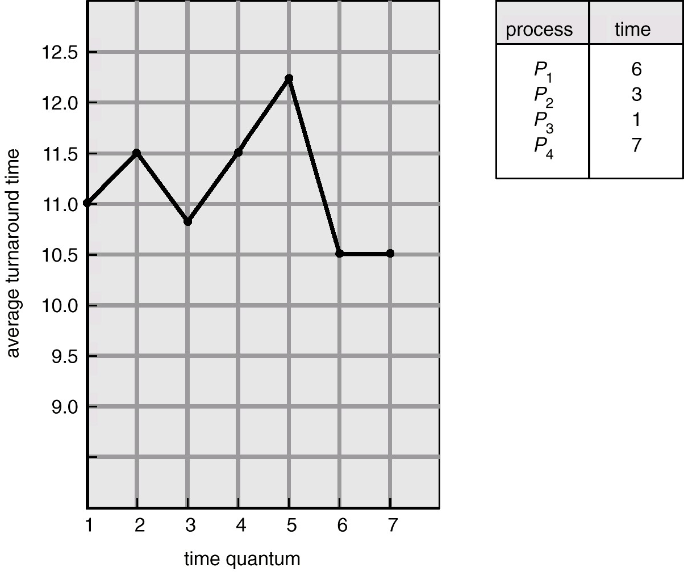
Turnaround Time Varies With The Time Quantum
 Increasing the time quantum does not necessarily improve the average turnaround time!
CS-2006 Operating Systems

Slide 20
5. Multilevel Queue Scheduling
Ready queue is partitioned into separate queues:
  For example, foreground (interactive) and background (batch)
Each queue has its own scheduling algorithm:
  Foreground – RR
  Background – FCFS
Scheduling must be done between the queues
  Fixed priority scheduling; (i.e., serve all from foreground then from background)
    Possibility of starvation
  Time slice – each queue gets a certain amount of CPU time which it can schedule amongst its processes
    i.e., 80% to foreground in RR and 20% to background in FCFS
CS-2006 Operating Systems

Slide 21
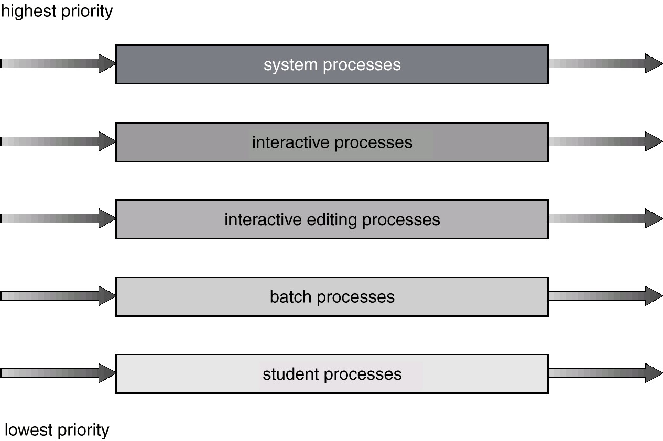
Multilevel Queue Scheduling
CS-2006 Operating Systems

Slide 22
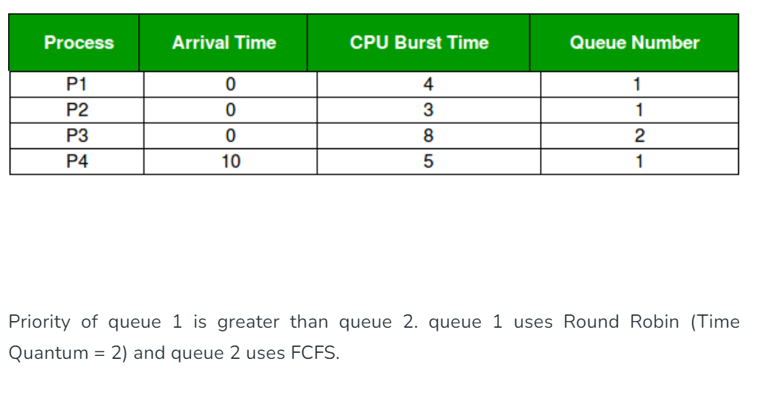

Slide 23
6. Multilevel Feedback Queue
 A process can move between the various queues; aging can be implemented this way
Multilevel-feedback-queue scheduler defined by the parameters:
  number of queues
  scheduling algorithms for each queue
  method used to determine when to upgrade a process
  method used to determine when to demote a process
following
method used to determine which queue a process will enter
when that process needs service
CS-2006 Operating Systems

Slide 24
Multilevel Feedback Queue Scheduling
Example
  If a process used too much CPU time, then move it to a lower- priority queue
  If a process waits too long in a lower priority queue, then move it to a higher priority queue
23
CS-2006 Operating Systems

Slide 25
Multilevel Feedback Queue
Three queues:
  Q₀ – time quantum 8 milliseconds
  Q₁ – time quantum 16 milliseconds
  Q₂ – FCFS
Scheduling
  A new job enters queue Q₀ which is served FCFS. When it gains CPU, the job receives 8 milliseconds. If it does not finish in 8 milliseconds, the job is moved to queue Q₁
  At Q₁ , the job is again served FCFS and receives 16 additional milliseconds. If it still does not complete, it is preempted and moved to queue Q₂
CS-2006 Operating Systems

Slide 26
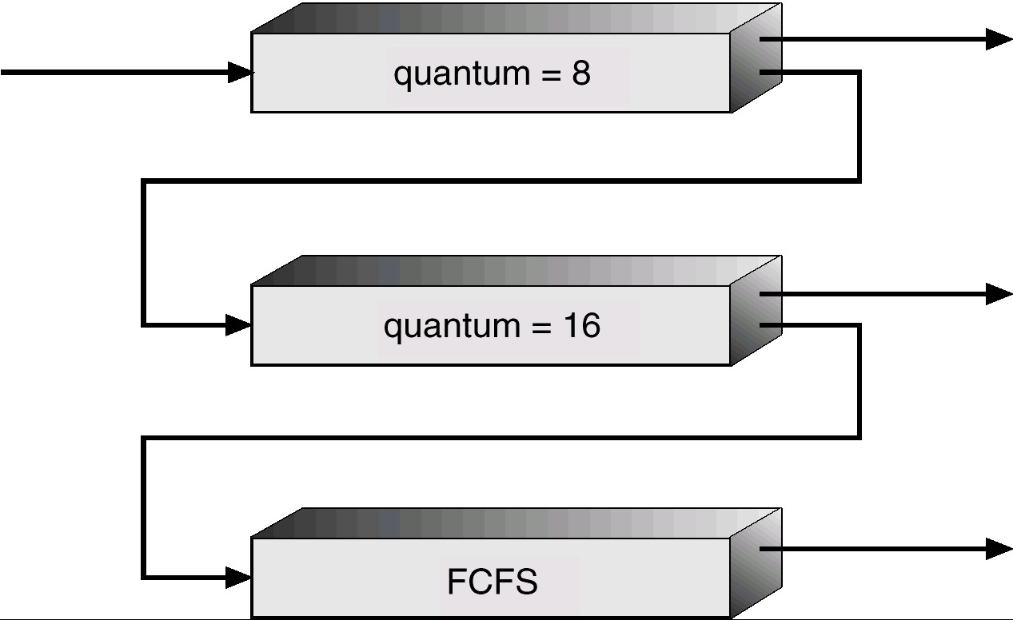
Multilevel Feedback Queue
CS-2006 Operating Systems

Slide 27
MLFQ Example
At t=0 there are three CPU bound processes (no I/O) in the system. The CPU burst lengths are: 30 units for P1, 20 units for P2, and 10 units for P3.The system has three RR queues with the following time slices: 1 for queue1, 2 for queue 2, and 4 for queue3. RR- 1 Unit of time slice
Gantt Chart
Average Completion Time
Average Waiting Time
CS-2006 Operating Systems

Slide 28
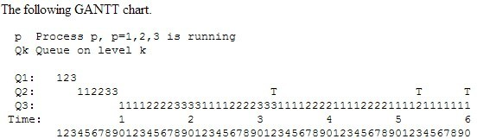
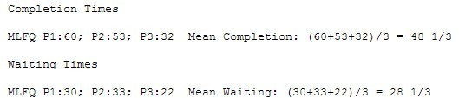
Solution:
CS-2006 Operating Systems

Slide 29
Summary of CPU Scheduling Algorithms
First-Come, First-Served (FCFS) Scheduling
Shortest-Job-First (SJF) Scheduling
  Nonpreemptive
  Preemptive or Shortest Remaining Time First (SRTF)
Priority Scheduling
  Preemptive
  Nonpreemptive
Round Robin (RR)
Multilevel Queue Scheduling
Multilevel Feedback Queue
CS-2006 Operating Systems

Slide 30
References
 Operating System Concepts (Silberschatz, 9th edition) Chapter 5
CS-2006 Operating Systems

